Slide 1
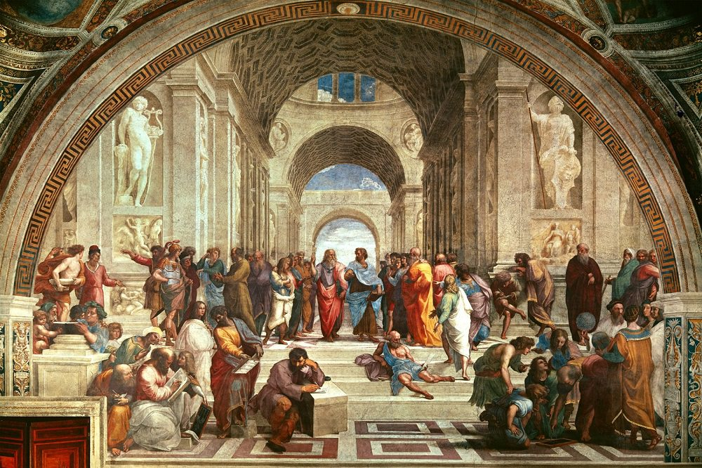
What is Classical Education?
Amy Gilbert Richards
Eastern University
Notes:
A continuous educational tradition originating in ancient Greece.
“the ancients believed that education was fundamentally about shaping loves. What one loved and treasured could be right or wrong according to how that love accorded to the structure of reality.” (4) as Catholics, we believe that God is the source of the structure of reality, and so a proper shaping of loves will point all of our loves towards God and then towards our neighbor and the structure of God’s creation.
“Grounded in piety, Christian classical education cultivates the virtue of the student in body, heart, and mind, while nurturing a love for wisdom under the lordship of Christ” (4)

Slide 2
What is Classical Education?
A What: classical education entails the consideration of particular subjects aimed towards forming a student’s mind and character.
A How: there are particular methods traditionally used to achieve such formation, which we will discuss as we move through the presentation.

Slide 3
“education is not primarily about the acquisition of information. It is not even about the acquisition of ‘skills’ in the conventional sense, to equip us for particular roles in society. It is about how we become more human (and therefore more free, in the truest sense of that word). This is a broader and deeper question, but no less practical. Too often we have not been educating our humanity. We have been educating ourselves for doing rather than being.”
–Stratford Caldecott

Slide 4
PGMAPT: A Guide to Understanding Classical Education (Kevin Clarke and Ravi Scott Jain, The Liberal Arts Tradition)
Piety
Gymnastic
Music
Art (The Seven Liberal Arts)*
Philosophy
Theology
* Note that ‘art’ here does not mean fine art or productive crafts

Slide 5
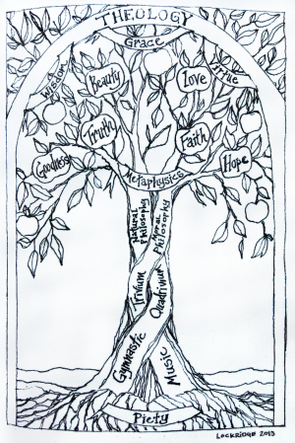

Slide 6
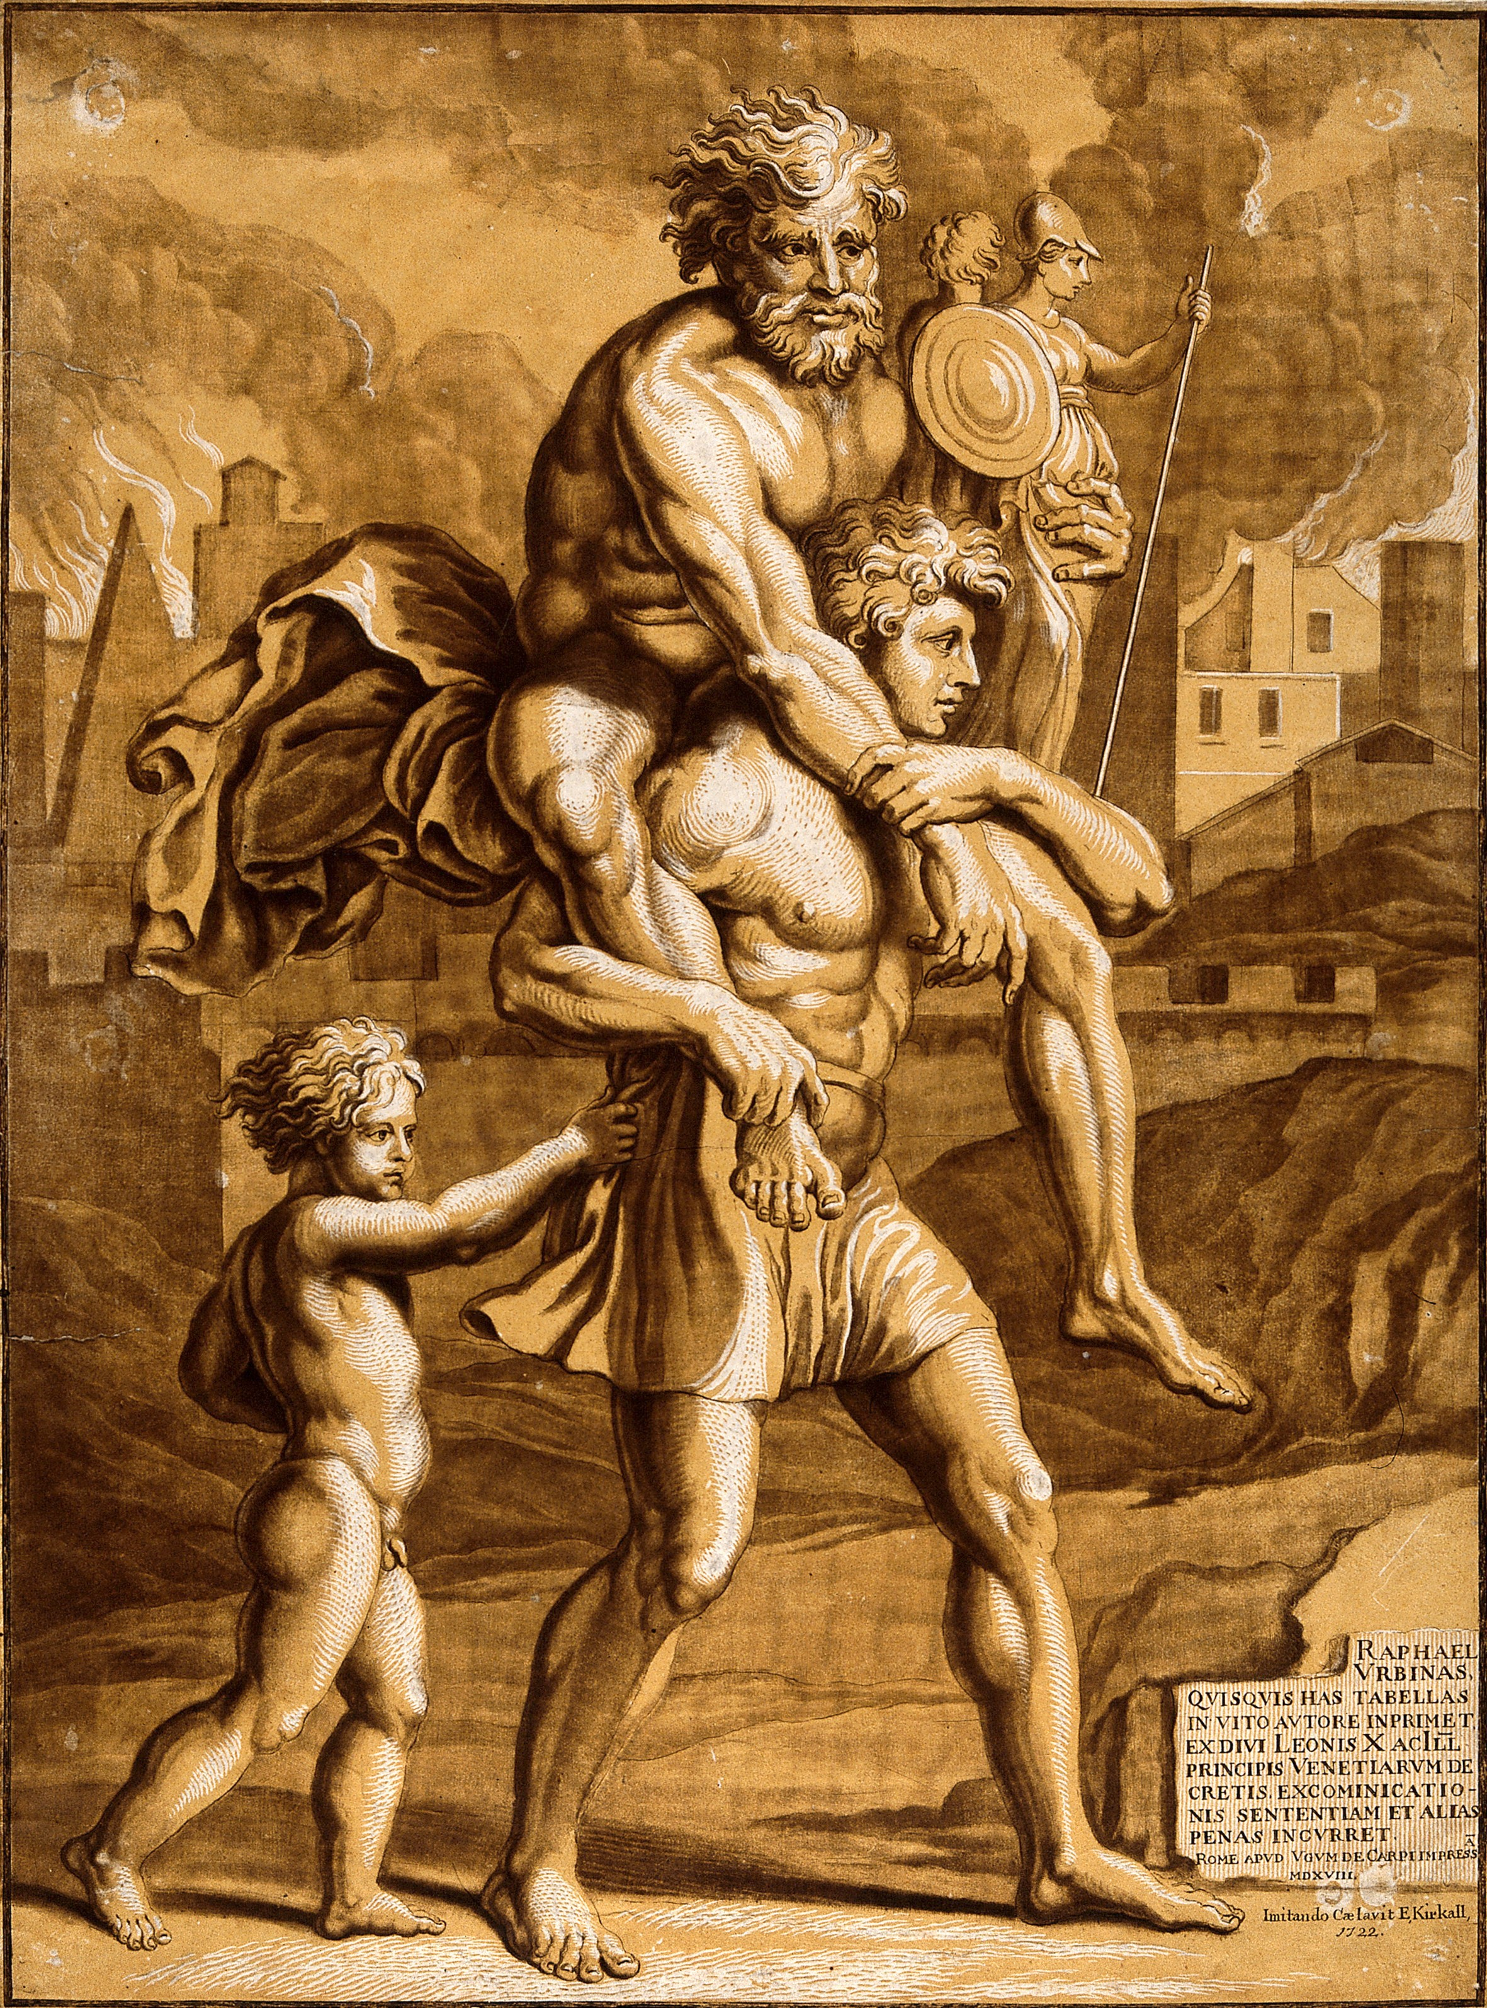
Piety
“the proper love and fear of God and Man”
We are “born into a morally defined cosmic order and [are] thus obliged to live in a way concomitant with that moral order” (Turley)
Passing on our heritage: parents as primary educators
Aeneas
Notes:
“The role of parents in education is of such importance that it is almost impossible to provide an adequate substitute. The right and duty of parents to educate their children are primordial and inalienable.” –The Catechism of the Catholic Church, para. 2221
the school culture must incarnate piety, virtue, and grace. For inevitably, the culture of the school educates as much as its curriculum.” (15)
“When the gods tell Aeneas that he must leave the burning city of Troy and take his people to a new homeland far away, his father Anchises—like any stubborn old man—at first refuses to go. He wants to die in his Trojan home, but Aeneas will not leave the old man’s side. It requires a sign from the heavens to persuade Anchises, and when he agrees, Aeneas carries his father on his shoulders (for Anchises is crippled), and takes his small son by the hand, while the father carries the figurines of the household gods, departed ancestors now made divine. It is the poem’s great emblem of piety. Indeed, whenever Aeneas has a decision to make—do we put in at port here, or press on?—he consults his father, the chief of the tribe.” –Anthony Esolen

Slide 7
Gymnastic and Music: Poetic Knowledge
Introduce the young to reality through delight
Total education engaging the memory, passions, and imagination.
Gymnastic and music (the Muses) recognize children as embodied beings.
All subjects in the early grades are musical in this sense: combining physical movement, song (Song School Latin), memorizing poetry, drawing, learning history through story, and experiencing and observing the natural world.

Slide 8
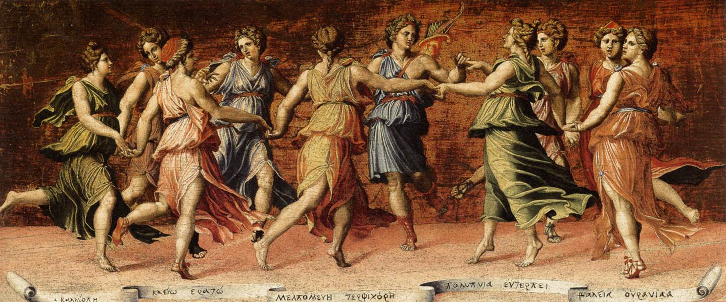
The Muses

Slide 9
The Seven Liberal Arts
Liberal Arts = the tools needed to create and justify knowledge
Provide essential tools—linguistic and mathematical—for all subsequent learning
How we learn what we need to know in order to be free persons, not dependent on our teachers
The ‘liberal’ arts thus contrasted with the ‘servile’ arts, which serve direct instrumental ends.

Slide 11
The Trivium: The study of language, taught through the study of literature
Grammar: Be!
Teaches us to understand language
Latin is crucial to learning grammar
Dialectic: Think!
Teaches us to separate truth from falsehood
Logic, formulating questions
Rhetoric: Speak!
Teaches us to argue effectively for a point of view
Cicero: “to move, to instruct, to delight”

Slide 12
The Quadrivium: The study of number and its relationship to physical space or time
Arithmetic:
The study of pure number
Geometry:
The study of number in space
Astronomy (Physics):
The study of number in time
Music:
The study of number in both space and time
Plato believed that the study of the mystery of number could awaken the inner vision of the soul, preparing it to understand philosophy and theology.

Slide 13
Philosophy
Love of wisdom in Natural, Moral, and Divine Philosophy
Natural Philosophy: modern natural science
Moral Philosophy: modern social science
Divine Philosophy: metaphysics, the study of being
The unity of knowledge that covers all subjects

Slide 14
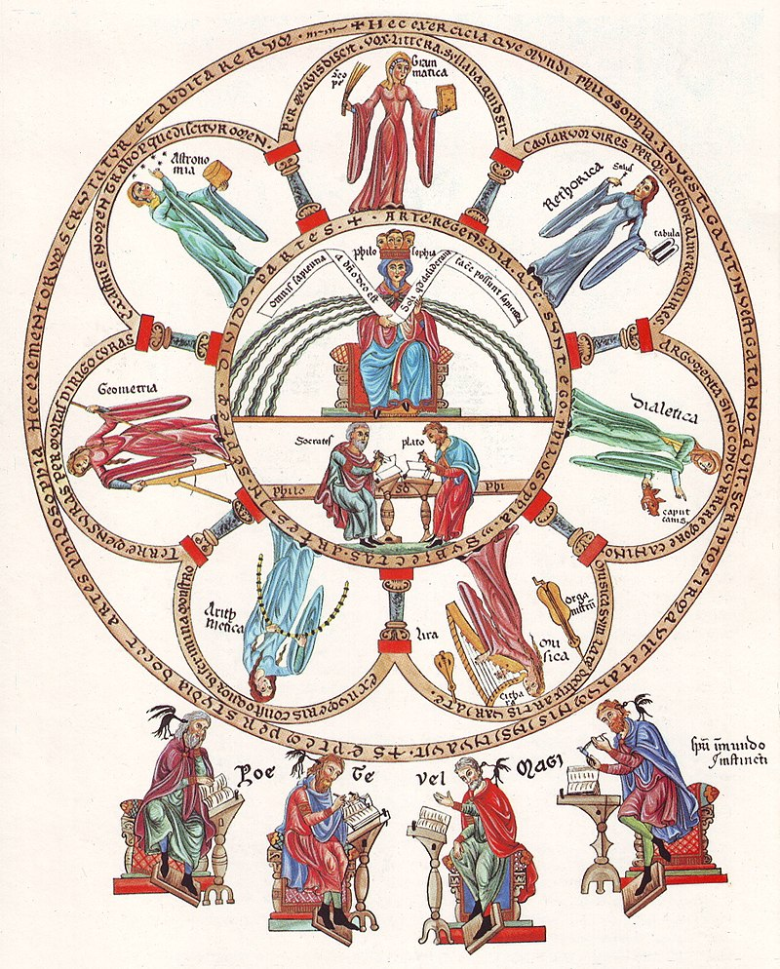
The Seven Liberal Arts ordered to Philosophy

Slide 15
Theology: The Science of Divine Revelation
Queen of the Sciences
Deals specifically with revealed truth, which provides the framework for the entirety of education
Governs the entirety of classical education as its telos.
“Theology orders our knowledge to its proper end in the worship and service of the Lord Jesus Christ.” --Clark and Jain

Slide 16
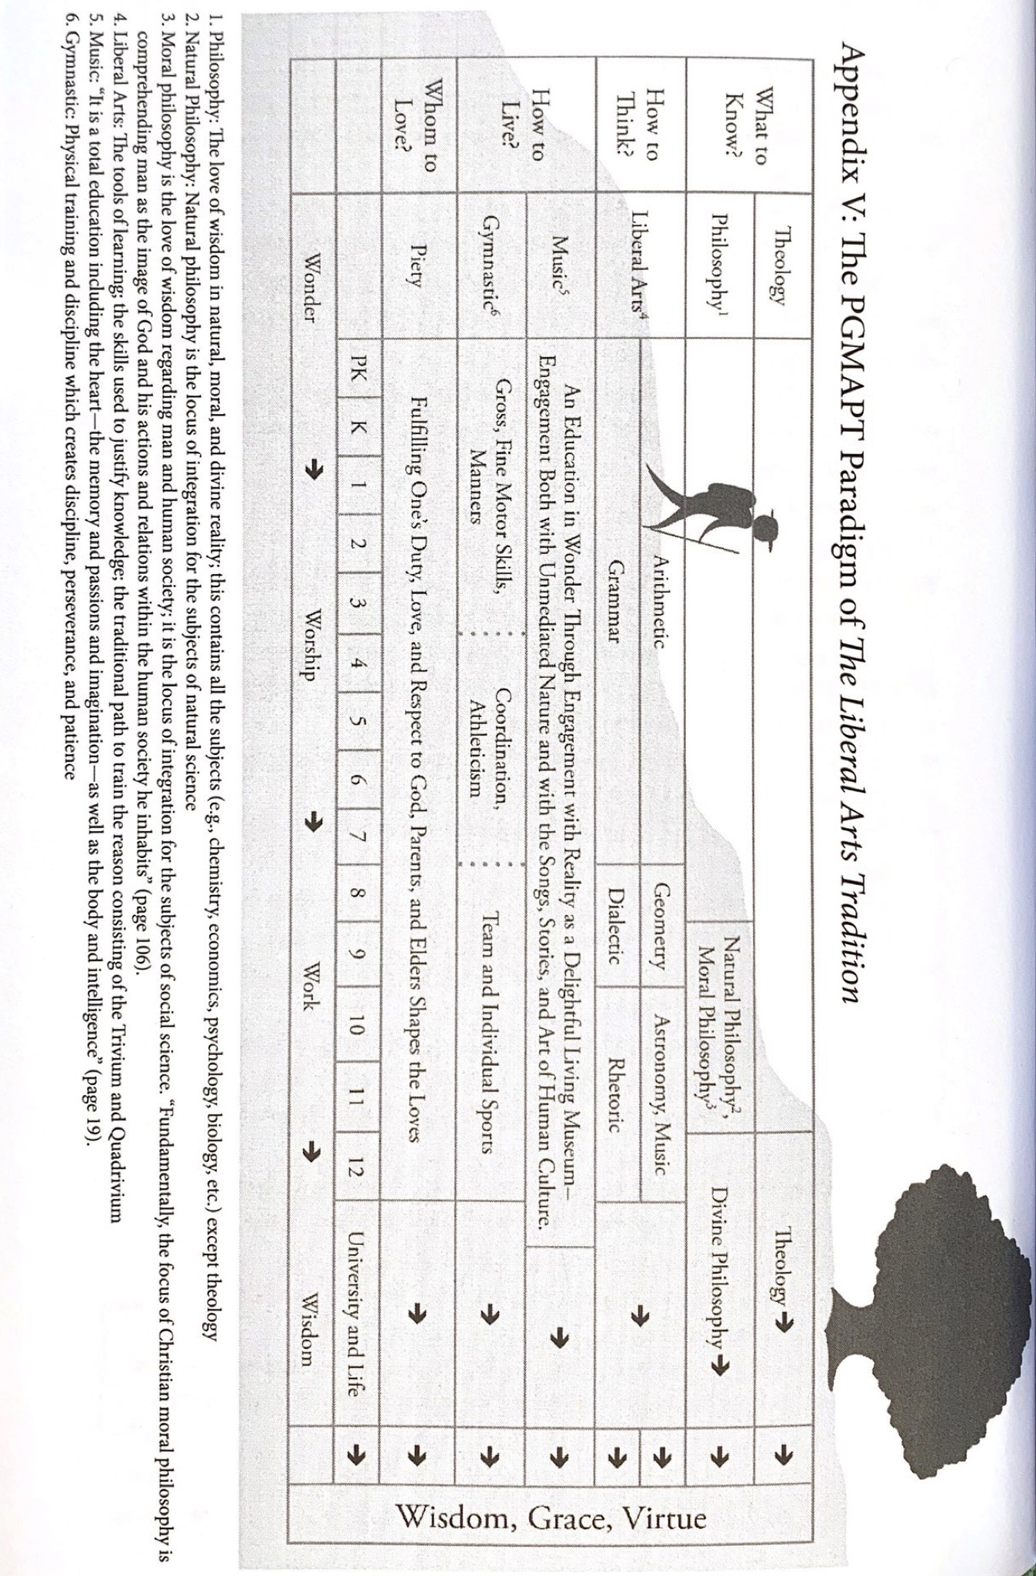

Slide 17
Why Catholic Classical Education?
Treats students as fully human
Gives priority to persons, rather than to instrumental ends
“Growth in prayer and growth in love is at the heart of education, for prayer involves interior opening to the supreme Other. It is the relationship to God made possible by this opening that strengthens us in our attempts to know and love the whole creation, and our neighbors as ourselves.” –Caldecott

Slide 18
Classical Education for Everyone
“There is no foundation for the complaint that only a small minority of human beings have been given the power to understand what is taught them, the majority being so slow-witted that they waste time and labor. On the contrary, you will find the greater number quick to reason and prompt to learn. This is natural to man.
. . .
‘But some have more talent than others.’ I agree: then some will achieve more and some less, but we never find one who has not achieved something by his efforts.”
--Quintillian, Institutio Oratioria, I:I.

Slide 19
Further Resources:
The Liberal Arts Tradition: A Philosophy of Christian Classical Education. Kevin Clark and Ravi Scott Jain. Classical Academic Press, 2013.
Beauty in the Word: Rethinking the Foundations of Education. Stratford Caldecott. Angelico Press, 2012.
Beauty for Truth’s Sake: On the Re-enchantment of Education. Stratford Caldecott. Brazos Press, 2017.
Simply Classical: A Beautiful Education for Any Child. Cheryl Swope. Memoria Press.2019.
Lectures on ClassicalU: www.classicalu.com/the-lecture-hall/

